Slide 1
Applications of Programming II - Regular Expressions, Web Scraping
Notes:
"If you're a programmer, a UX (user experience) designer or an expert in Python, artificial intelligence and machine learning... or better still, you create robots, you have no shortage of jobs.“
Vivian Balakrishnan

Slide 2
Objectives
At the end of this lecture, you will learn about more applications of programming as follow:
Regular Expressions
Web Scraping
Notes:
This week we will cover the topics: strings, operators, getting user input and mathematical functions.

Slide 3
Regular Expressions

Slide 4
What is a regular expression?
Regular expression ("regex"): a description of a pattern of text
can test whether a string matches the expression's pattern
can use a regex to search/replace characters in a string
regular expressions are extremely powerful but tough to read
the regular expression below matches basic email addresses
E.g. "([A-Za-z0-9]+[.-_])*[A-Za-z0-9]+@[A-Za-z0-9-]+(\.[A-Z|a-z]{2,})+”

Slide 5
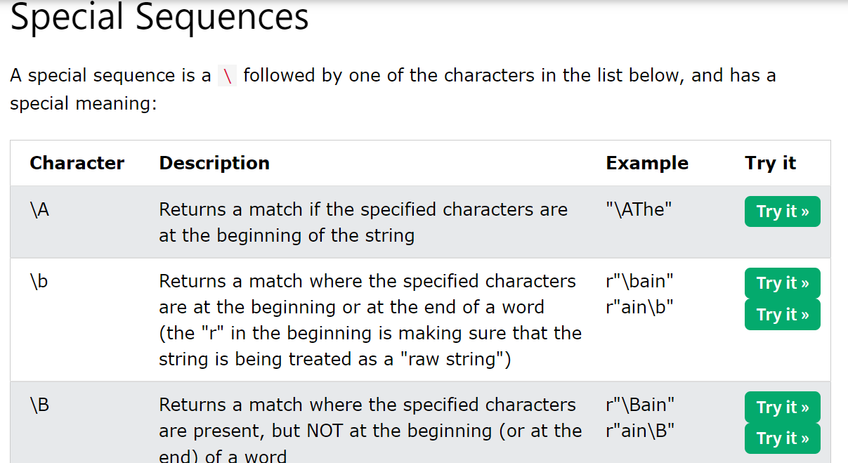
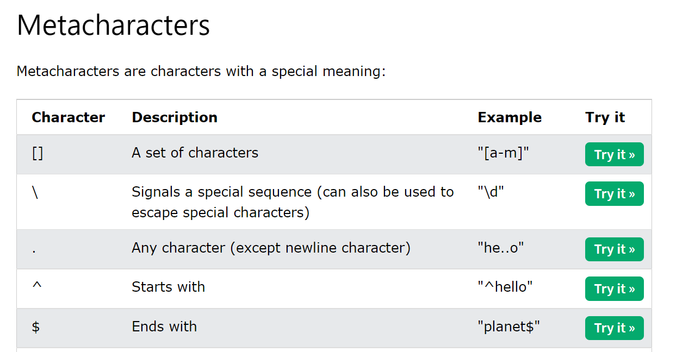
Regular Expressions
To learn more about how Regular Expressions work
Visit https://www.w3schools.com/python/python_regex.asp to find out how Metacharacters or Special Sequences works by using the “Try it” functions

Slide 6
Example – Use Regular Expressions to validate an email address
import re
regex = re.compile(r'([A-Za-z0-9]+[.-_])*[A-Za-z0-9]+@[A-Za-z0-9-]+(\.[A-Z|a-z]{2,})+')
def isValid(email):
if re.fullmatch(regex, email):
print("Valid email")
else:
print("Invalid email")

Slide 7
Web Scraping

Slide 8
Web Scraping
Web Scraping is the process of extracting information and data from a website, transforming the information on a webpage into structured data for further analysis.
urllib is a standard Python library and contains functions for requesting data across the web, handling cookies, and even changing metadata such as headers and your user agent.
The requests library is the de facto standard for making HTTP requests in Python.

Slide 9
Example – Find email addresses
import urllib.request, re # re is regular expression
req = urllib.request.Request("https://www.np.edu.sg",
headers={'User-Agent': 'Mozilla/5.0'})
s = urllib.request.urlopen(req).read().decode('utf-8')
# specify the regex for finding emails and return as a set
emails = set(re.findall(r"[A-Za-z0-9._%+-]+@[A-Za-z0-9.-]+\.[A-Za-z]{2,4}",s))
#phone_numbers = set(re.findall(r"\d{4}\s\d{4}", s))
# print all the emails
for e in emails:
print(e)

Slide 10
Reading Reference
Regular Expressions: Regexes in Python (Part 1)
https://realpython.com/regex-python/
https://www.w3schools.com/python/python_regex.asp
Python Web Scraping Tutorials
https://realpython.com/tutorials/web-scraping/
Requests Library
https://requests.readthedocs.io/en/master/
https://realpython.com/python-requests/
Notes:
Here are references you can use to find out more about regular expressions and web scraping

Slide 11
Summary
Regular Expressions
Web Scraping
Notes:
In this lecture, we have looked at applications of Programming and web scraping

